Slide 1
The A List
Tanay Khopey, Philip Clement, Jonathan Hsin, Ahman Hale, Camden Johnson

Slide 2


Problem Statement
Staying focused and on track is something that almost all of us has struggled with whether it being in school, a job, or in out personal life. As a result, it’s critical for many people to clearly define their goals and objectives to better manage their time. To satisfy this need, we propose a a to-do app that allows clients to organize and prioritize their daily tasks to lead a more productive day.

Slide 3
Proposed Solution
We propose a to-do list application which will help users stay on track, and organize and complete their projects efficiently and without confusion. We acknowledge that there are many to-do list apps that exist, as a result, we will draw inspiration from existing applications and integrate our team’s creative ideas to make a to-do list app that:
meets the client’s requirements,
includes some original and unique features, and
is completed in a timely manner using the Prototyping software engineering process

Slide 4
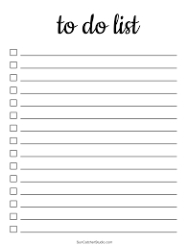
How Our Solution Relates to the Project Goal
Time management
Customizability
Ease of use

Slide 5
Requirement Use Case
Use Case: Add a Task to Todo List
Preconditions
User must be authenticated and have access to the todo list functionality.
Main Flow
User requests to add a task to their todo list. System prompts user to enter task details. User inputs task details and confirms. System adds the task to the todo list and confirms the addition.
Subflows
User selects "Add Task" option from the menu or clicks on the "Add Task" button.
System displays a form asking the user to input task details such as task name, due date, priority, and any additional notes.
User fills out the task details and confirms submission.
System confirms successful addition of the task to the user's todo list.

Slide 6

Use Case Contd.
Alternative Flows
User cancels the task addition process.
System cancels the task addition and returns the user to the main menu or previous screen.
Task details provided by the user are incomplete or invalid.
System prompts the user to provide the required information or correct the invalid details.

